Slide 1
DIY PROJECT
Team G

Slide 2
Project Assigned
Computer Vision Based
System that will track the motion of a moving object , and a signal will be given when the object crosses the line.

Slide 3
Objectives and scope of the project
The objective of goal line technology is not to replace the role of the officials , but rather to support them in their decision-making .
This System doesn’t rely on cameras , instead using magnetic field to the track the ball .
This technology has effectively reduced the controversies around so-called “goal-line incidents” during the games .

Slide 4
Team Members And Roles
Shivam Undare : Hardware
Annanya Agrawal : Software and Code
Dhondi Keshava : Software and Code
Shailaja Pentewad : Circuit Design and Coordination
Preparation of ppts and presentation is distributed among all team members equally.

Slide 5
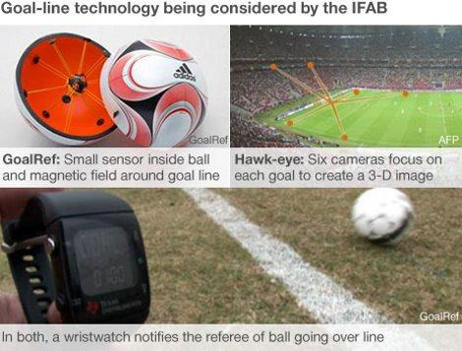
This System that does not rely on cameras, instead using a magnetic field to track the ball. A sensor is embedded inside the ball, which detects the magnetic field produced by thin wires run underneath the penalty box. A computer tracks the position of the ball via the sensor and detects when the ball crosses the goal line .

Slide 6
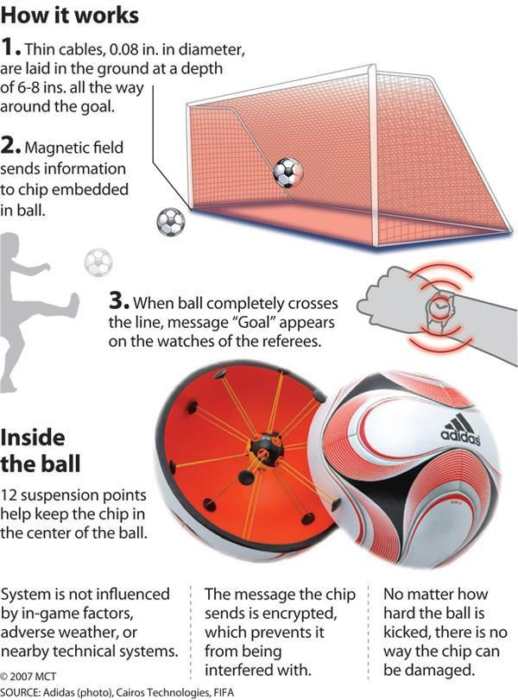

Slide 7
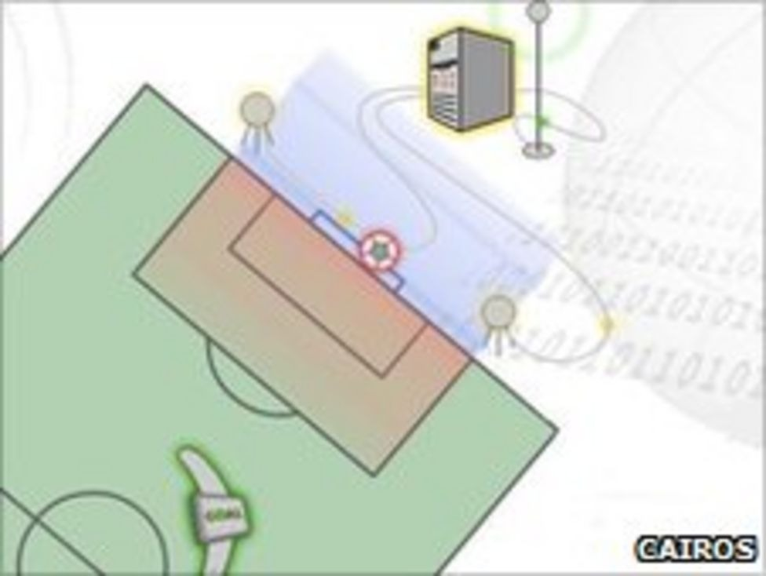
3 GoalRef GoalRef features a passive electronic circuit embedded in the ball and a low-frequency magnetic field around the goal. Any change in the field on or behind the goalline is detected by coils embedded in the goal frame, which determine the scoring of a goal. By producing low magnetic fields around the goals, GoalRef creates the radio equivalent of a light curtain [6]. As soon as the ball has wholly crossed the goal line between the posts, a change in the magnetic field is detected. A goa

Slide 8


Slide 9
Softwares used :
TiNker cad for circuit
ArDuino IDE for code

Slide 10
COMPONENTS
Name of the components | Quantity | Cost
Arduino Uno Board | 1 | 862 Rs
PIR sensor | 1 | 199 Rs
BUZZER | 1 | 80 Rs
Ultrasonic sensor | 1 | 220 Rs
Breadboard | 1 | 168 Rs
LED | 1 | 36 Rs
Jumper wires |  | 185 Rs
Total expenses |  | 1750 Rs

Slide 11
Component status
Name of the components | Quantity | Status
Arduino Uno Board | 1 | Received
PIR sensor | 1 | Received
BUZZER | 1 | Received
Ultrasonic sensor | 1 | Received
Breadboard | 1 | Received
LED | 1 | Received
Jumper wires |  | Received

Slide 12

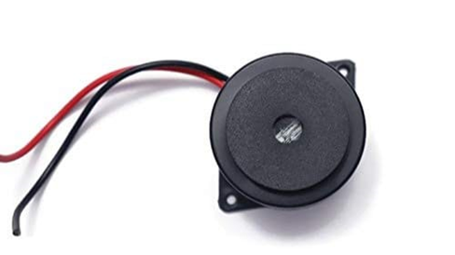
Part Technical Specifications
Arduino Uno R3.
ATmega328P based microcontroller
Operating voltage of 5V
Conprises of 14 -digit l/O pins
BUZZER
A buzzer or beeper is an audio signaling device, which may be mechanical, electromechanical, or piezoelectric (piezo for short).

Slide 13
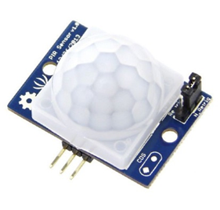
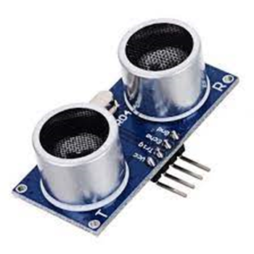
PIR SENSOR
ULTRASONIC SENSOR
Senses infrared signal emitted by various objects.
Sensing range is about 7 metres ( 100 degree cone)
Input voltage : DC 4.5-20 volts
Level output : High 3.3V / Low 0V
Measures distance through ultrasound which travels through the air.
Ranging distance : 2cm-4m
Power supply : DC 5V
Operating current : 8mA
Working frequency : 40Hz

Slide 14
Plan Of Action
Assemble the circuit when we receive the components.
We will be using ultrasonic sensor and pir sensor at first to detect the object.
Ultrasonic sensor, uses ultrasonic rays to detect the object and can also tell the distance. It is usually used in radar systems
PIR sensor uses heat signals to detect the object , hence a point over ultrasonic sensor, which cannot detect soft objects.
We can also use screen to show distance between the line and the object.

Slide 15
Week 1 & 2 progress
Ordered the components online .
Received some of the components.
Made a sample hardware to check the working of the components.
Created Circuit Diagram .

Slide 16
Week 3
Completed the coding part for each sensor .
Combined both the code and made the final code.
Designed the final hardware as per the circuit made in the tinkercad.
Tested the working of the hardware using the final code.
Week 4
Arranged the hardware model with the sensors in a suitable positions for the goal line technology.
Tested the model with soft as well as hard objets (eg: paperball , season ball etc. )
Making a video to publish on youtube with the working of model and suitable explanations.

Slide 17
FINAL CODE
int LED = 13;
int PIR = 5; int const trigPin = 2;
int const echoPin = 3;
int const buzzPin = 8;
void setup() {
pinMode(LED, OUTPUT);
pinMode(PIR, INPUT);
pinMode(LED_BUILTIN, OUTPUT);
pinMode(trigPin, OUTPUT);
pinMode(echoPin, INPUT);
pinMode(buzzPin, OUTPUT);
Serial.begin(9600);
}

Slide 18
void loop(){
if (digitalRead(PIR) == HIGH) {
digitalWrite(LED, HIGH);
digitalWrite(LED_BUILTIN, HIGH);
Serial.println("Motion detected!");
delay(10);
}
else {
digitalWrite(LED, LOW);
digitalWrite(LED_BUILTIN, LOW);
Serial.println("Motion stopped!");
delay(10); }
int duration, distance;
digitalWrite(trigPin, HIGH);
delay(1);

Slide 19
digitalWrite(trigPin, LOW);
duration = pulseIn(echoPin, HIGH);
distance = (duration/2) / 29.1;
if (distance <= 50 && distance >= 0) {
digitalWrite(buzzPin, HIGH);
} else {
digitalWrite(buzzPin, LOW);
}
delay(60);
}

Slide 20
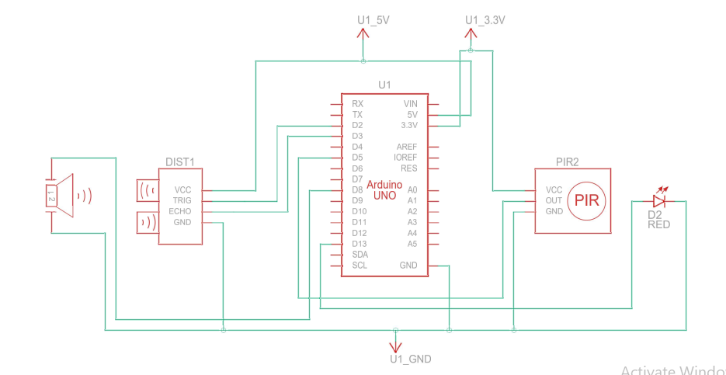
Schematic view of final circuit

Slide 21
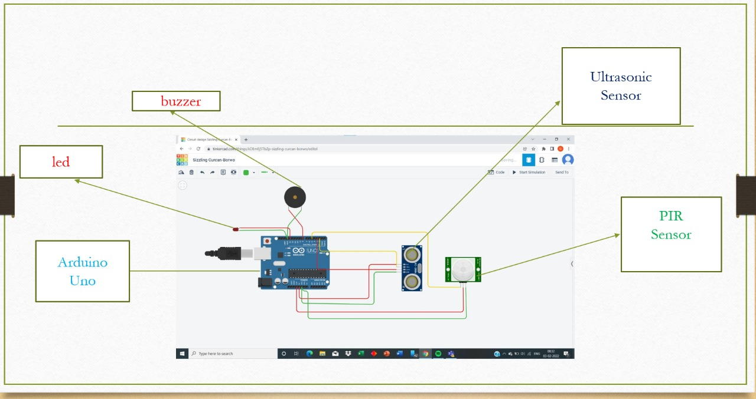
Circuit Diagram

Slide 22
what each team member did for the project?
Shivam
Whole hardware part
Ordering and receiving the components.
Designed the circuit with the help of team members.
Annanya
Done the coding part for the PIR sensor in arduino IDE
Made the final video to explain the code .
Collected all the vedio and made a final one

Slide 23
what each team member did for the project?
Keskava
Done the code for the Ultrasonic sensor.
Combined the two codes to make the code for the final circuit.
Helped Annanya in video editing .
Shailaja
Made the final circuit diagram in tinker cad.
Made the final video to describe the circuit parts .
Helped Shivam in positioning the sensors .

Slide 24
What we could achieve and what was left out
We could achieve the basic idea behind goal line technology and make the project work
Also the distance between the ball and the goal line could have achieved by using camera/screen feature but could not do so due to lack of machine learning knowledge and budget issues.
It was also planned to make a separate goal post and fix the sensors in it but in the end we decided to use a square study table for the project , but it served the same purpose of acting as a goal post.

Slide 25
THANK YOU

